Slide 1





Aviation Engineering Directorate
Cargo Helicopters
Project Management Office
End Game Qualification Methodology
for
Rotorcraft Actual Navigational Performance
3 May 2011

Slide 2

End Game Qualification Methodology
for
Rotorcraft Actual Navigational Performance
3 May 2011

Slide 3
Agenda
Purpose/Intent
Requirement Extraction
Methodology Development
Methodology Implementation
Methodology Evaluation
Conclusions/Summary
Contact Info

Slide 4
Purpose/Intent
Share with the community a methodology suitable for use with a continuously maturing system in a high cost environment, which requires high fidelity analysis from the relatively small sample sizes available for certification.
Notes:
Risk Reduction
Unknowns (Performance – Statistic confidence -
Limited Resources
Constantly changing Configuration (unstable – maturing -
volatile
Present the methodology developed and used in the CH-47F RNP RNAV
Paper is to describe the methodology
Equivalent Level of Safety certification process

Slide 5
Requirements Extraction
1 of 2
Army Requirements
  Operation in civil airspace during peacetime
    Clearance/conformance/safety
  Operation in DVE (“Brown-out”)
    Precision movements (sling load ops)
    Operations w/o controller support

Slide 6
Requirements Extraction
2 of 2
Civil Airspace Requirements
  Future - Performance Based Nav (“Free-Flight”)
  Current – RCTA D.O. 236 Minimum Requirements for Operation in RNP RNAV Airspace
Rockwell Collins CH-47F Preliminary Analysis
  Components of Total System Error
  Analysis of Individual Error Components

Slide 7
Methodology Development
1 of 2
Legacy
  WBS, decompose and build test data package
  Level of Performance, sample testing and statistical confidence as data set (RNP-10)

Slide 8
Methodology Development
2 of 2
“End Game”
  Hypothesis: Performance Failure
    Variability unrestrained
    Distribution unknown
  Focus on Risk Reduction for cost and schedule
    Data collection required exceeds for this analysis
    Sample Size where

Slide 9
Methodology Implementation
1 of 2
Preliminary RNP Analysis
  Total System Error
  Sample Size Assessment
End Game Accuracy Data Collection
  Flight Operations
  Instrumentation (Independent Sensor & Data Recording)

Slide 10
Methodology Implementation
2 of 2
Modified Legacy Testing
  Box to Subsystem to System
  Cost v. Data Collection v. Analysis
Final analysis
  Putting It All Together

Slide 11
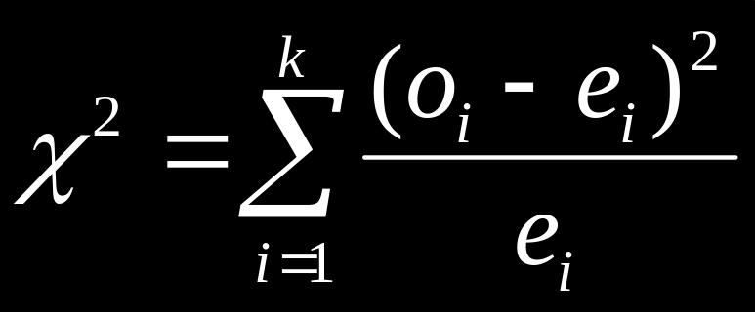
Methodology Evaluation
1 of 2
“End Game”
  Verification of sample size
    Population test
  Optimize the data (minimal unrecoverable resouce usage)
    Multi use / Reuse (for Requirement Assessment)
    Aggregation of analytical components
    Consolidated Planning (HW, SW, Labs, and Data Analysis)
    Risk Reduction (number of requirements met, sensor, fms,
    Cost reduction/avoidance (See all above)

Slide 12
Methodology Evaluation
2 of 2
Final analysis
  Population test
    Expandable data set for additional applicability
  Qualification Statement
    Confidence in Results

Slide 13
Conclusions/Summary
“End Game” Methodology has applicability beyond current use on CH-47F Helicopter
  CH-47F is only first of several U.S Army Helicopters to seek RNP RNAV Certification
Provides a more understandable and programmatically palatable method through which to obtain management support for statistical analysis efforts
Methodology is under test by PM Cargo Helicopters
  Results to be published

Slide 14
Contact Info
Graham Emore
  US Army, AMRDEC, Aviation Engineering Directorate
  graham.emore@us.army.mil
Mark Gulley
  SURVICE Engineering Company
  mark.gulley@survice.com
Charles SanFilippo
  US Army, PEO Avn, PM Cargo Helicopters
  charles-sanfilippo@us.army.mil

