Slide 1
Fuel Consumption Model for Tactical Operations Centers (TOCs)
Jennifer Barker
SURVICE Engineering Company
Jennifer.barker@survice.com

Slide 2
Background
CERDEC conducted a power assessment in 2008
  Three Command Posts (CPs): the Brigade Main, the Infantry Battalion CP and the MAIN Tactical CP.
  Eight days of mission equipment operation.
AMSAA requested SURVICE Engineering Company conduct a study to account for the fuel consumed.
By then end of the study, SURVICE had accounted for 97% of the reported fuel used during TOCFEST.
Resulting model can be used to predict fuel usage for TOCs – any weather conditions, shelters, shelter configuration, mission equipment layout, generators, and ECUs.
Notes:
AutoDISE computer model provided by the PM for Mobile Electric Power to determine the physical layout of the CPs. The team used the HVAC requirements calculator and custom designed Excel worksheets to estimate the amount of fuel used in each of the shelters that composed the CPs.
The team used hourly weather data and other shelter internal environmental conditions data to calculated HVAC loads in each shelter. The team used these loads combined with environmental conditioning unit (ECU) data to determine hourly fuel usage in each shelter.

Slide 3
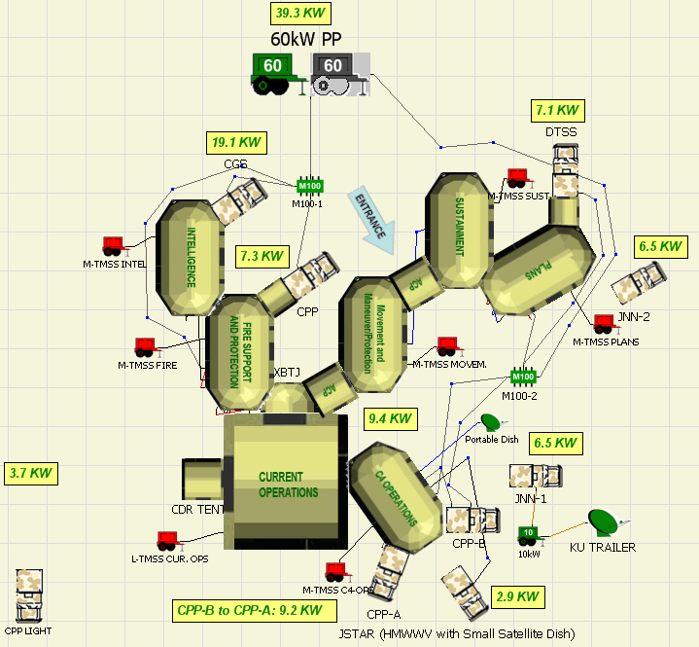
BCT Main CP
Notes:
Explain that this is one of three CPs making up the TOC that was examined during TOCFEST.
Point out the shelters, connector shelters, TMSSs.
Explain that fuel was consumed by HMMWVs, PPs, and TMSSs. We are assuming that the HMMWV fuel was separate so, for the purposes of the study, the fuel was only consumed by PPs (powering mission equipment) and TMSSs (powering lights and ECUs for the shelters).

Slide 4
Problem Statement
Find: the fuel consumed by TMSSs during TOCFEST
Given:
Total daily fuel usage & calculated fuel usage by power plants
Shelter and mission equipment layouts
Dates evaluated
Weather conditions
ECU capacities and TMSS fuel consumption rates
Tools:
AutoDISE software
HVAC Requirements calculator (part of AutoDISE)
SURVICE Fuel Consumption Model
Notes:
Mention that we assumed steady-state temperature to use the HVAC requirements calculator.

Slide 5
Additional Input
Assumptions made in the following areas:
  ECU settings
  TOC hours of operation
  # personnel in each shelter
  Conditions within shelters
  Ground conditions
  Solar and electrical contribution to heat load
Notes:
COP = coefficient of performance

Slide 6
Approach
Determine:
Heating required (BTUs)
Electrical Power to generate heating (BTU to kW)
Fuel to produce total power (kW to gal)
Shelter
(BTUs required)
ECU
(BTUs to kW)
Generator
(kW to gal)
Heat (BTU)
Power (kW)
Fuel
AutoDISE
SURVICE Model
Notes:
Talking point: Solution: build a model that will translate each shelter’s hourly heat requirements into fuel consumed.

Slide 7
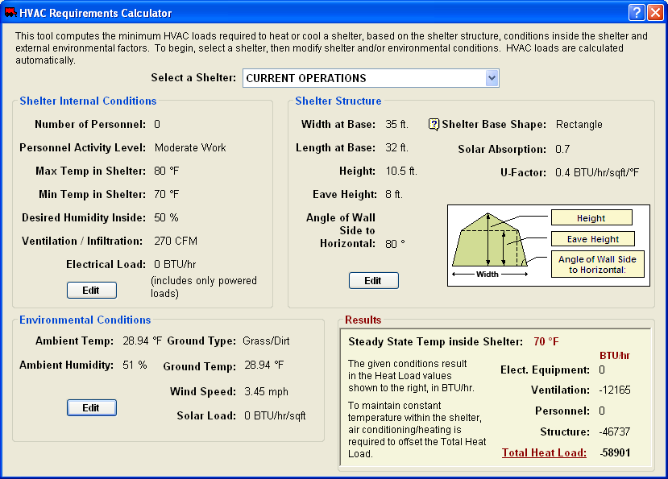
HVAC Requirements
Calculator
Notes:
Used this tool and changed conditions by the hour.

Slide 8
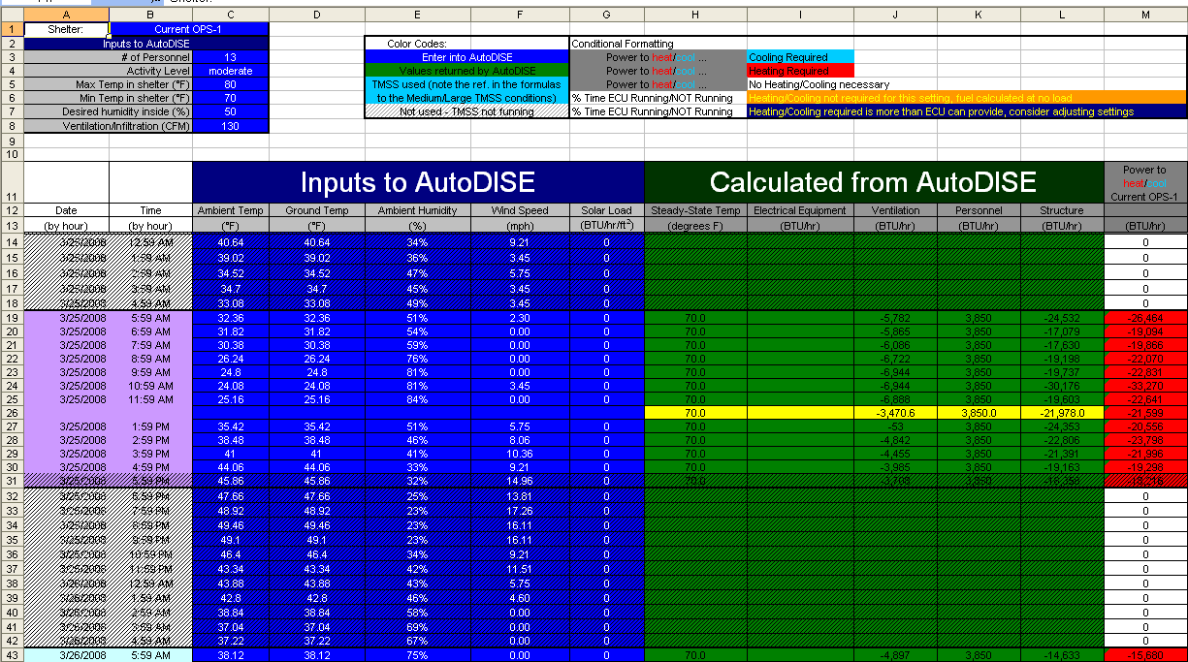
AutoDISE Input/Output
Notes:
Account for the hourly changes within the model.

Slide 9
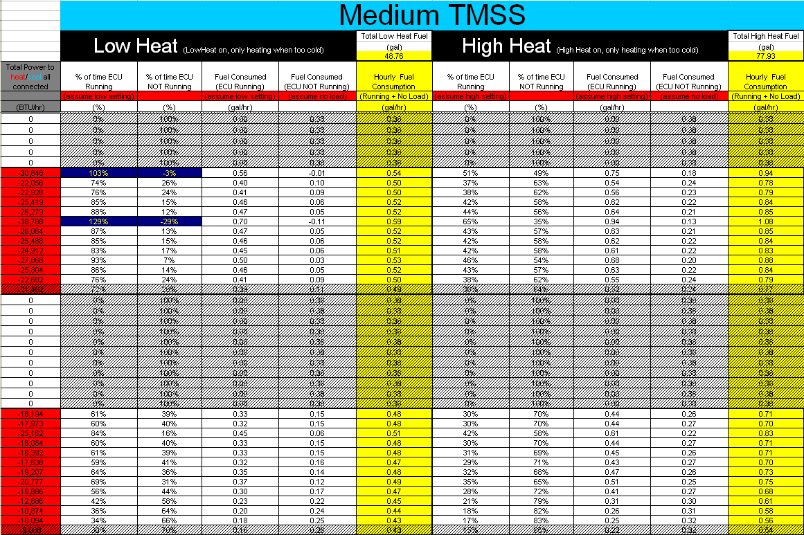
Fuel Consumption Calculations

Slide 10
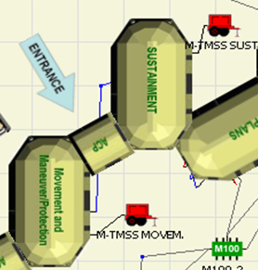
Common Conditions
TMSS ECU COP = 1 (Resistance heating)
Fuel for HMMWV’s not included in analysis
Distribution of Connector tent heat load
TMSS
TMSS
Heat load calculated separately
Heat Load Distributed
Actual Layout

Slide 11
Study Conditions
 | Scenario 1 (Original Assumptions) | Scenario 2 | Scenario 3
Heat Setting | Low | Low | High
Hours of Operation | 0600-1800 | 0600-1900 | 0600-1900
# Personnel | # laptop stations | 0 | 0
Internal Temperature | 65-80°F | 70-80°F | 70-80°F
Desired Humidity | 50% | 50% | 50%
Ventilation/Infiltration | # laptop stations | # laptop stations | # laptop stations
Ground Type | Dirt/grass | Dirt/grass | Dirt/grass
Ground Temperature | Air temperature | Air temperature | Air Temperature
Solar Load | 0 BTU/hr | 0 BTU/hr | 0 BTU/hr
Conversion of Electrical Load to Heat Load | 100% | 0% | 0%
Notes:
The team conducted the study by investigating three scenarios, each of which addresses a unique combination of inputs, conditions, and assumptions. Scenario 1 was our baseline, Scenario 2 Scenario 3 includes assumptions made on the most accurate information.

Slide 12
Scenario 1 Fuel Consumption

Slide 13
Scenario 2 Fuel Consumption

Slide 14
Scenario 3 Fuel Consumption

Slide 15
Fuel Consumption (gals)
Date | Scenario 1 | Scenario 2 | Scenario 3 | Consumed by TMSSs
3/25/2008 | 61.40 | 79.74 | 137.37 | 129.6
3/26/2008 | 52.75 | 72.80 | 107.88 | 168.6
3/27/2008 | 54.53 | 76.10 | 117.88 | 43.6
3/28/2008
3/29/2008 | 64.99 | 81.13 | 147.54 | 177.6
3/30/2008 | 69.25 | 82.00 | 157.13 | 77.6
3/31/2008 | 60.22 | 79.58 | 135.95 | 210.6
4/1/2008 | 50.40 | 65.77 | 88.71 | 111.6
4/2/2008 | 59.61 | 79.45 | 134.73 | 140.6
Total | 473.15 | 616.58 | 1027.18 | 1059.8

Slide 16
Conclusion
SURVICE model had accounted for 97% of the reported fuel used during TOCFEST.
Resulting model can be used to predict fuel usage for TOCs – any weather conditions, shelters, shelter configuration, mission equipment layout, generators, and ECUs.
The model shows what factors can significantly affect fuel usage.
Notes:
Further confidence in the model can be attained with more detailed data collection.– expand on this thought to explain the first bullet.
We could gain confidence in the model by comparing to an exercise with more accurate and more focused data collection.
Given accurate input data, we could predict fuel usage for deployed TOCs (for resource planning).

Slide 17
BACKUP

Slide 18
Potential Fuel Consumption based on Fuel Consumption Data from CERDEC
Generator Operating Conditions | TMSS Size | Fuel Consumption | Daily Fuel Consumption (12 hrs/day) |  | 8-day total Fuel Consumption | Qty of TMSS size in TOC | Fuel Consumed per TMSS size (8-day total) | Potential Fuel Usage for TOCFEST
 |  | (gal/hr) | (gal/day) |  | (gal) |  | (gal) | (gal)
Full Load | Medium | 1.46 | 17.52 |  | 140.16 | 10 | 1401.6 | 1629.12
 | Large | 2.37 | 28.44 |  | 227.52 | 1 | 227.52
Half Load | Medium | 0.54 | 6.48 |  | 51.84 | 10 | 518.4 | 615.36
 | Large | 1.01 | 12.12 |  | 96.96 | 1 | 96.96
No Load | Medium | 0.38 | 4.56 |  | 36.48 | 10 | 364.8 | 388.8
 | Large | 0.25 | 3 |  | 24 | 1 | 24
Recorded fuel used during TOCFEST |  |  |  | 1231
Report estimated fuel consumption by PP |  |  |  | 171.2 | 14%
Report estimated fuel consumption by TMSS’s |  |  |  | 1059.8 | 86%

